Slide 1


Microservices won’t eat your spaghetti
LINDY HUTZ

Slide 2




Lindy Hutz
Solution architect at Team Rockstars IT
Eindhoven, The Netherlands
https://www.linkedin.com/in/lindyhutz/ https://github.com/lhutz
Notes:
Dutch Silicon Valley

Slide 3

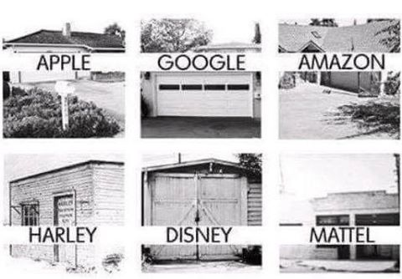

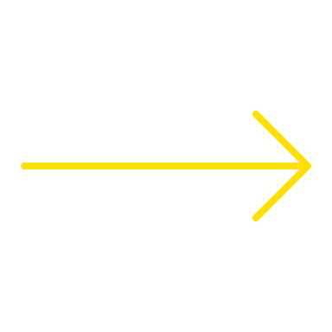

Notes:
Dutch Silicon Valley

Slide 4
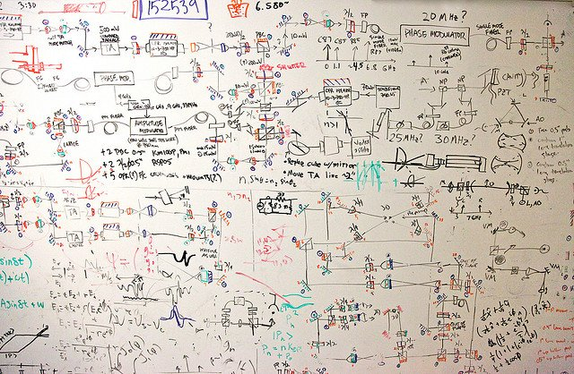
Notes:
Dutch Silicon Valley

Slide 5
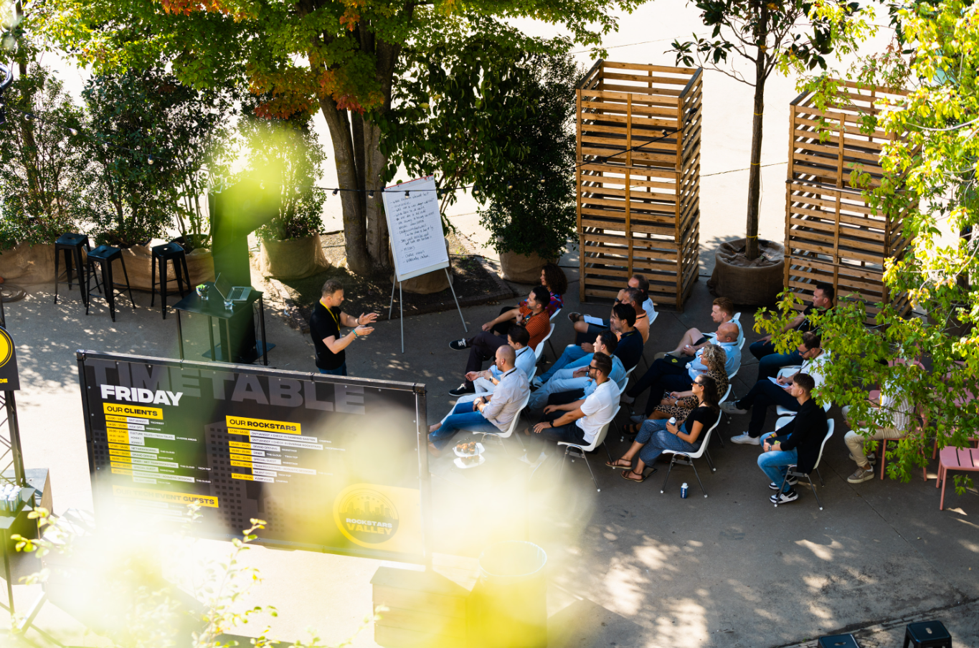

Why won’t microservices eat spaghetti?

Slide 6
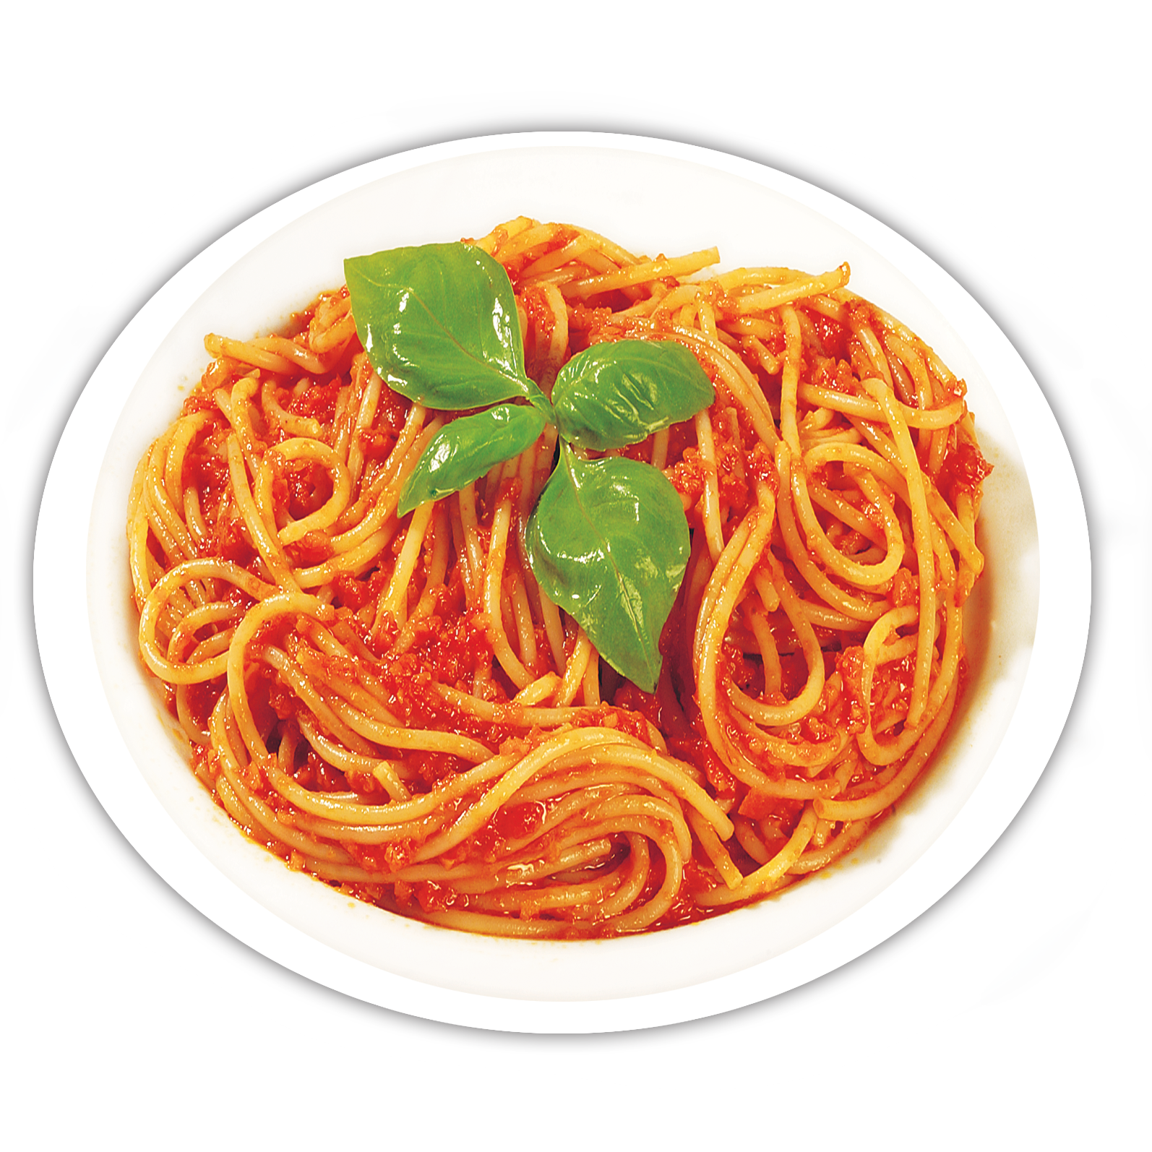
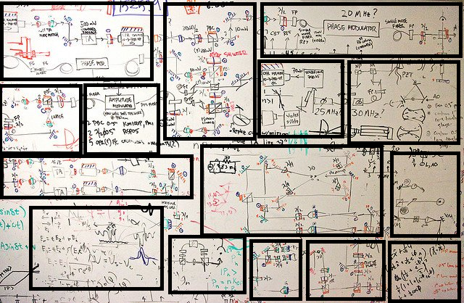
Buon appetito!
Notes:
If you do what you did, you get what you got. Distributed.

Slide 7
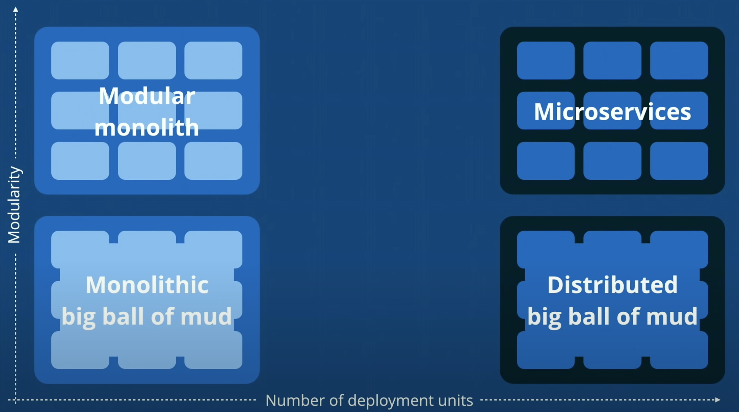


From: Modular Monoliths by Simon Brown
Notes:
Simon Brown

Slide 8

If you do what you did, you’ll get what you got, just distributed.

Slide 9
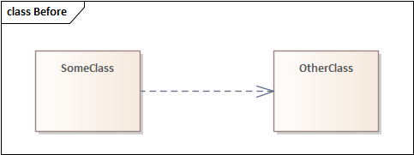
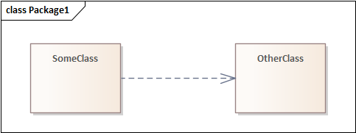


Slide 10
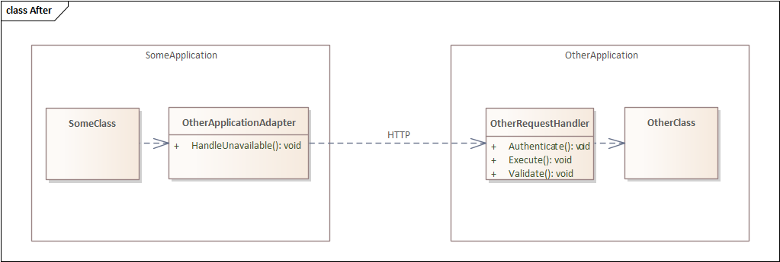
Notes:
Added sauce to spaghetti

Slide 11
So how do you add modularity?

Slide 12
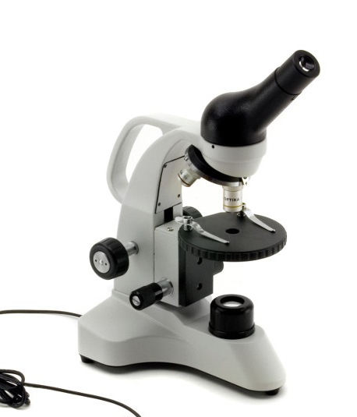

Slide 13

Architects be like…

Slide 14
Notes:
Dutch Silicon Valley

Slide 15
C4 Model

Slide 16
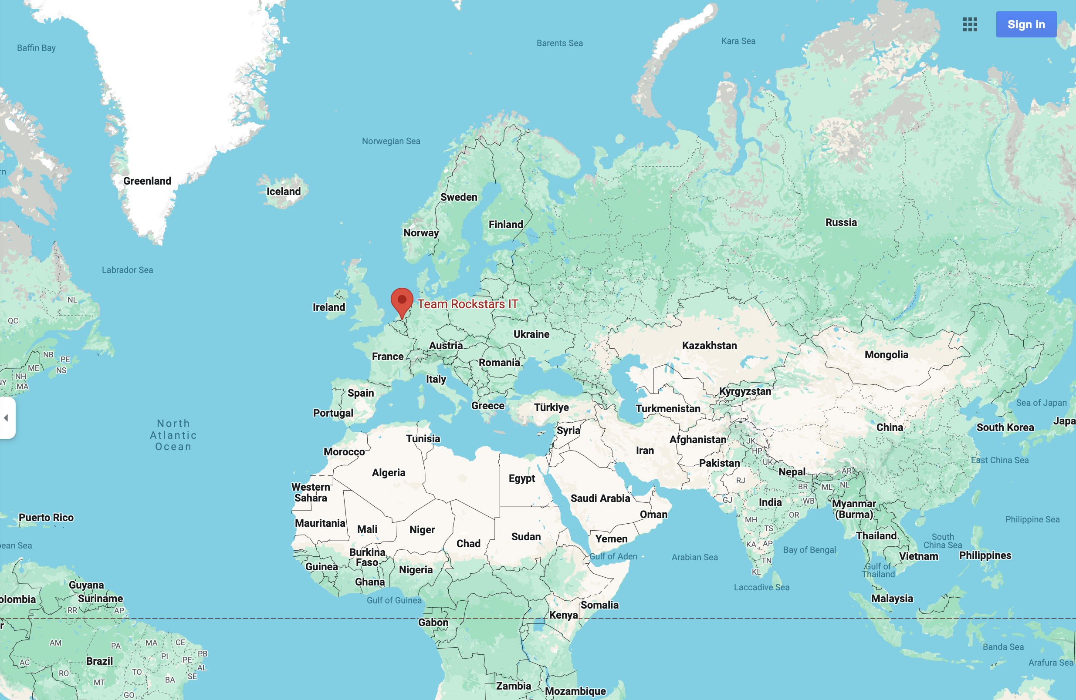
Notes:
Netherlands

Slide 17
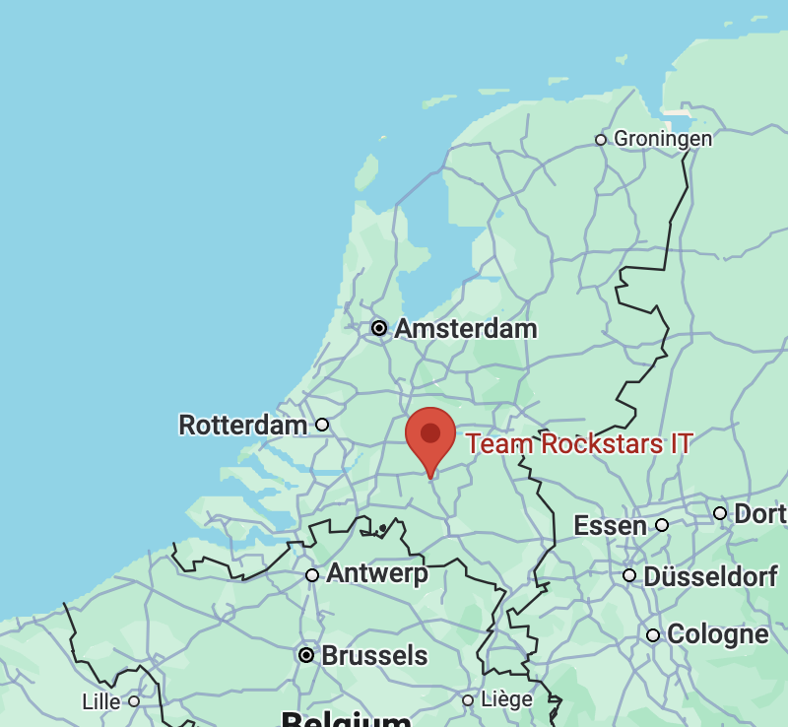
Notes:
Brabant

Slide 18

Notes:
Den Bosch

Slide 19
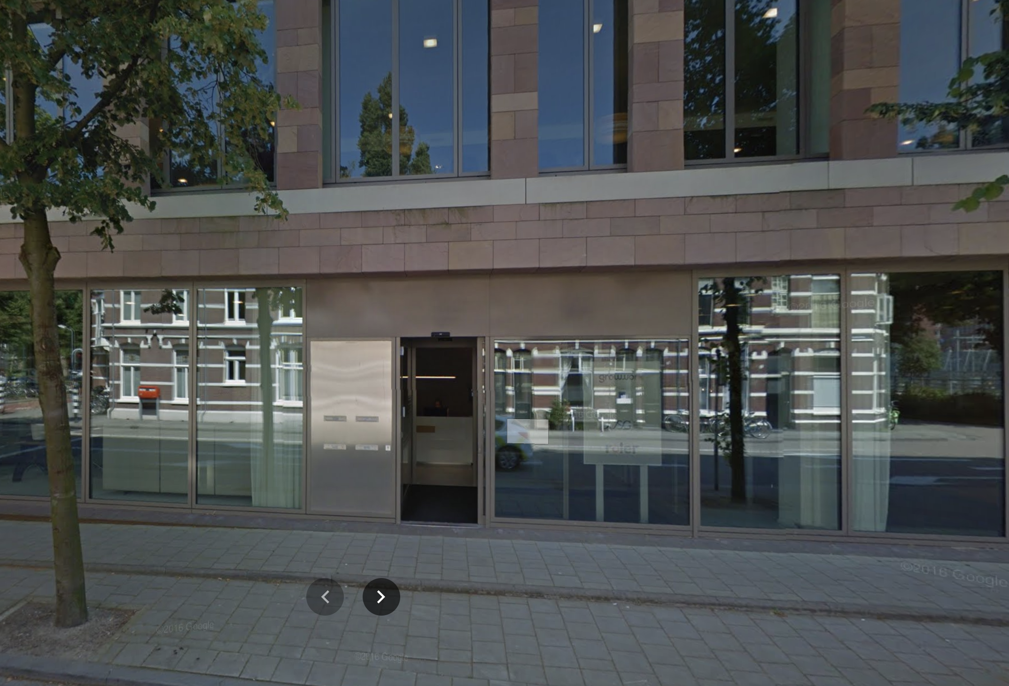
Notes:
Lekkerbeetjesstraat US -> don’t say door is grey

Slide 20
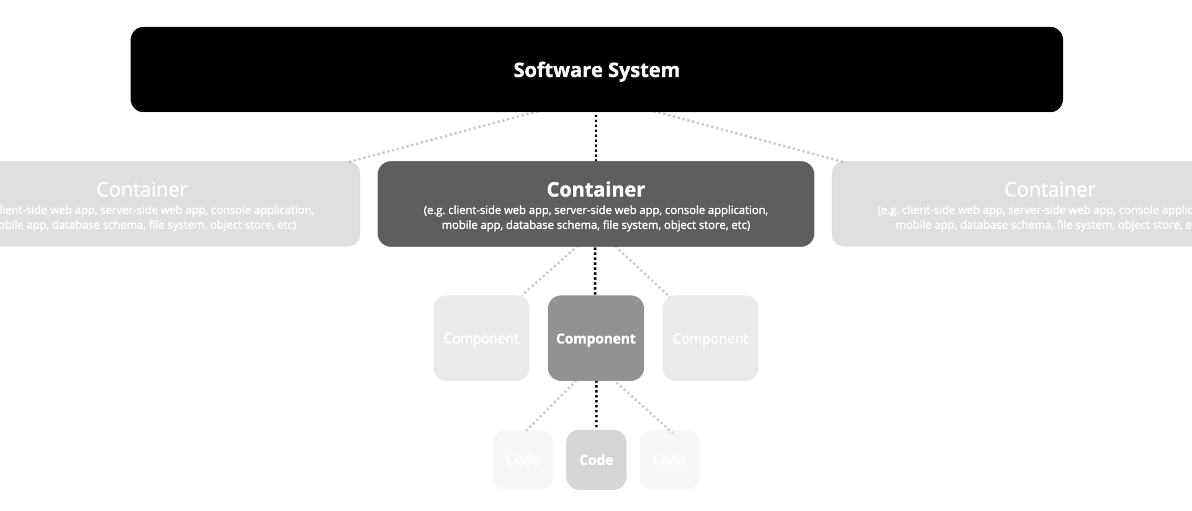
Context
Source: https://c4model.com/
Notes:
Simon Brown

Slide 21
Example: Vase webshop

Slide 22



Notes:
Simon Brown

Slide 23
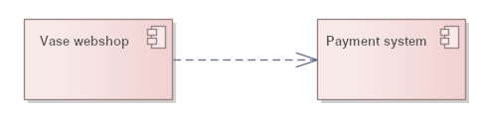
C1: Context

Slide 24
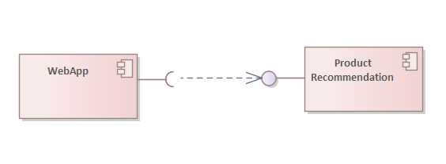
C2: Container

Slide 25
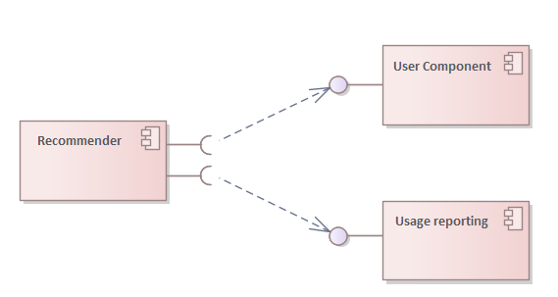
C3: Component

Slide 26
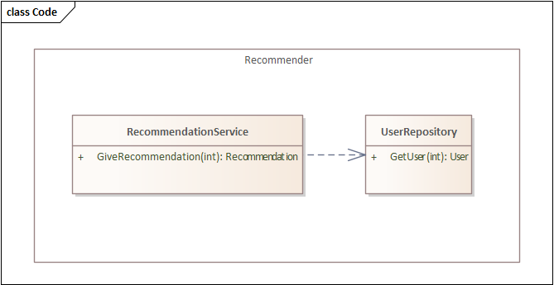
C4: Code

Slide 27
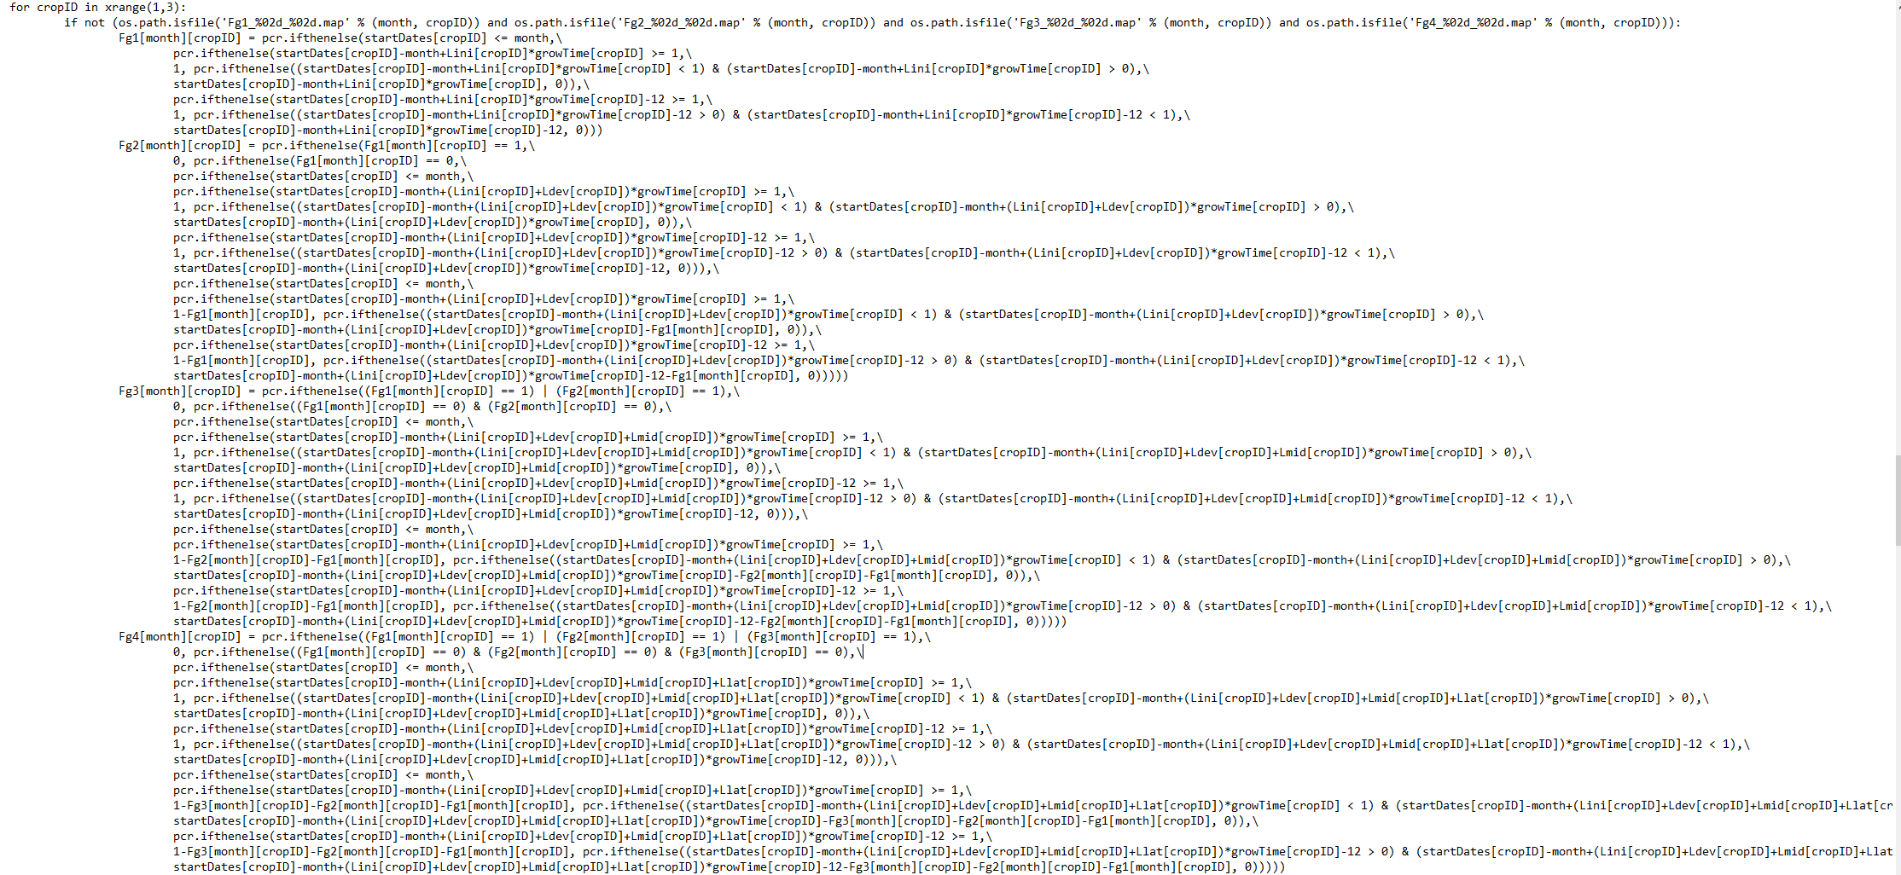

Slide 28
C1: Context
Notes:
Imagine talking about methods that are in this picture

Slide 29
So how do you split up the spaghetti?

Slide 30

Event storming

Slide 31
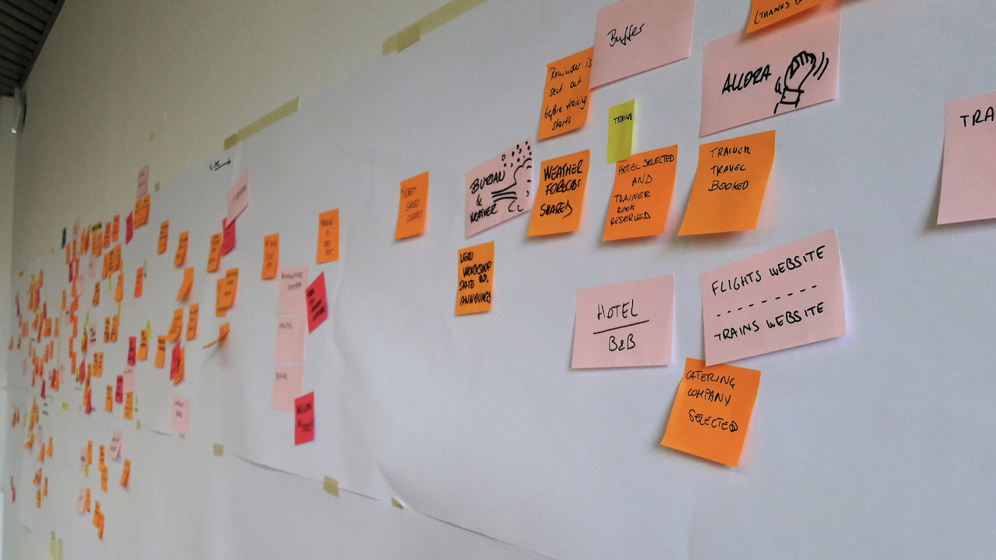
From: https://github.com/ddd-crew/ddd-starter-modelling-process
Notes:
Link at end

Slide 32
Notes:
Simon Brown

Slide 33
Vase Bought at Flea Market
PictureTaken
Description Written
Vase Published
Customer Liked Vase
Vase Added To Shopping Basket
Customer Placed Order
Vase Packed
Vase Sent
Vase Delivered
Review Placed

Slide 34
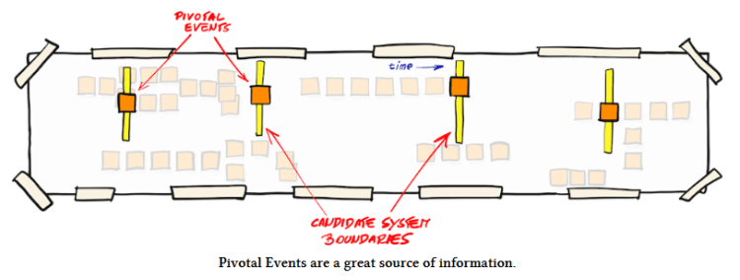
From: https://leanpub.com/ddd_first_15_years
Notes:
Link at end

Slide 35
Vase Bought at Flea Market
PictureTaken
Description Written
Vase Published
Customer Liked Vase
Vase Added To Shopping Basket
Customer Placed Order
Vase Packed
Vase Sent
Vase Delivered
Review Placed

Slide 36
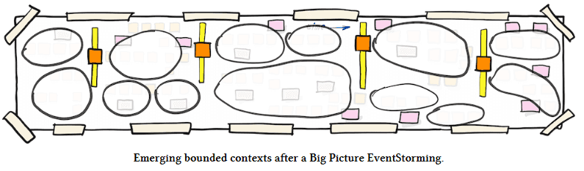
From: https://leanpub.com/ddd_first_15_years
Notes:
Link at end

Slide 37
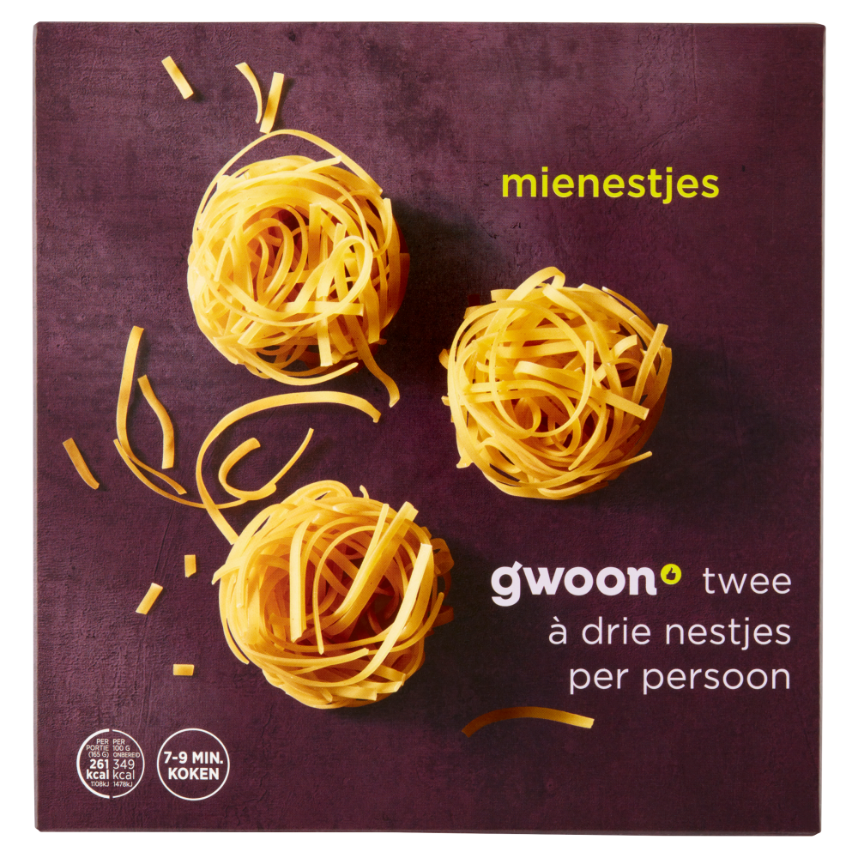

Slide 38
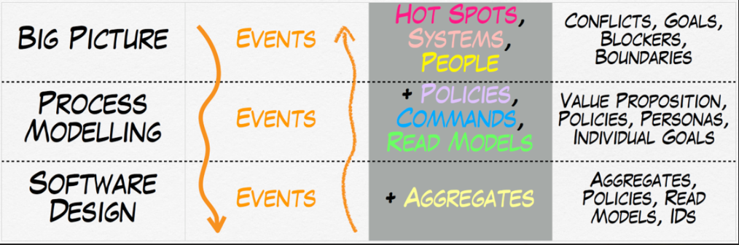
From: Alberto Brandolini – 100,000 stickies
Notes:
Link at end

Slide 39
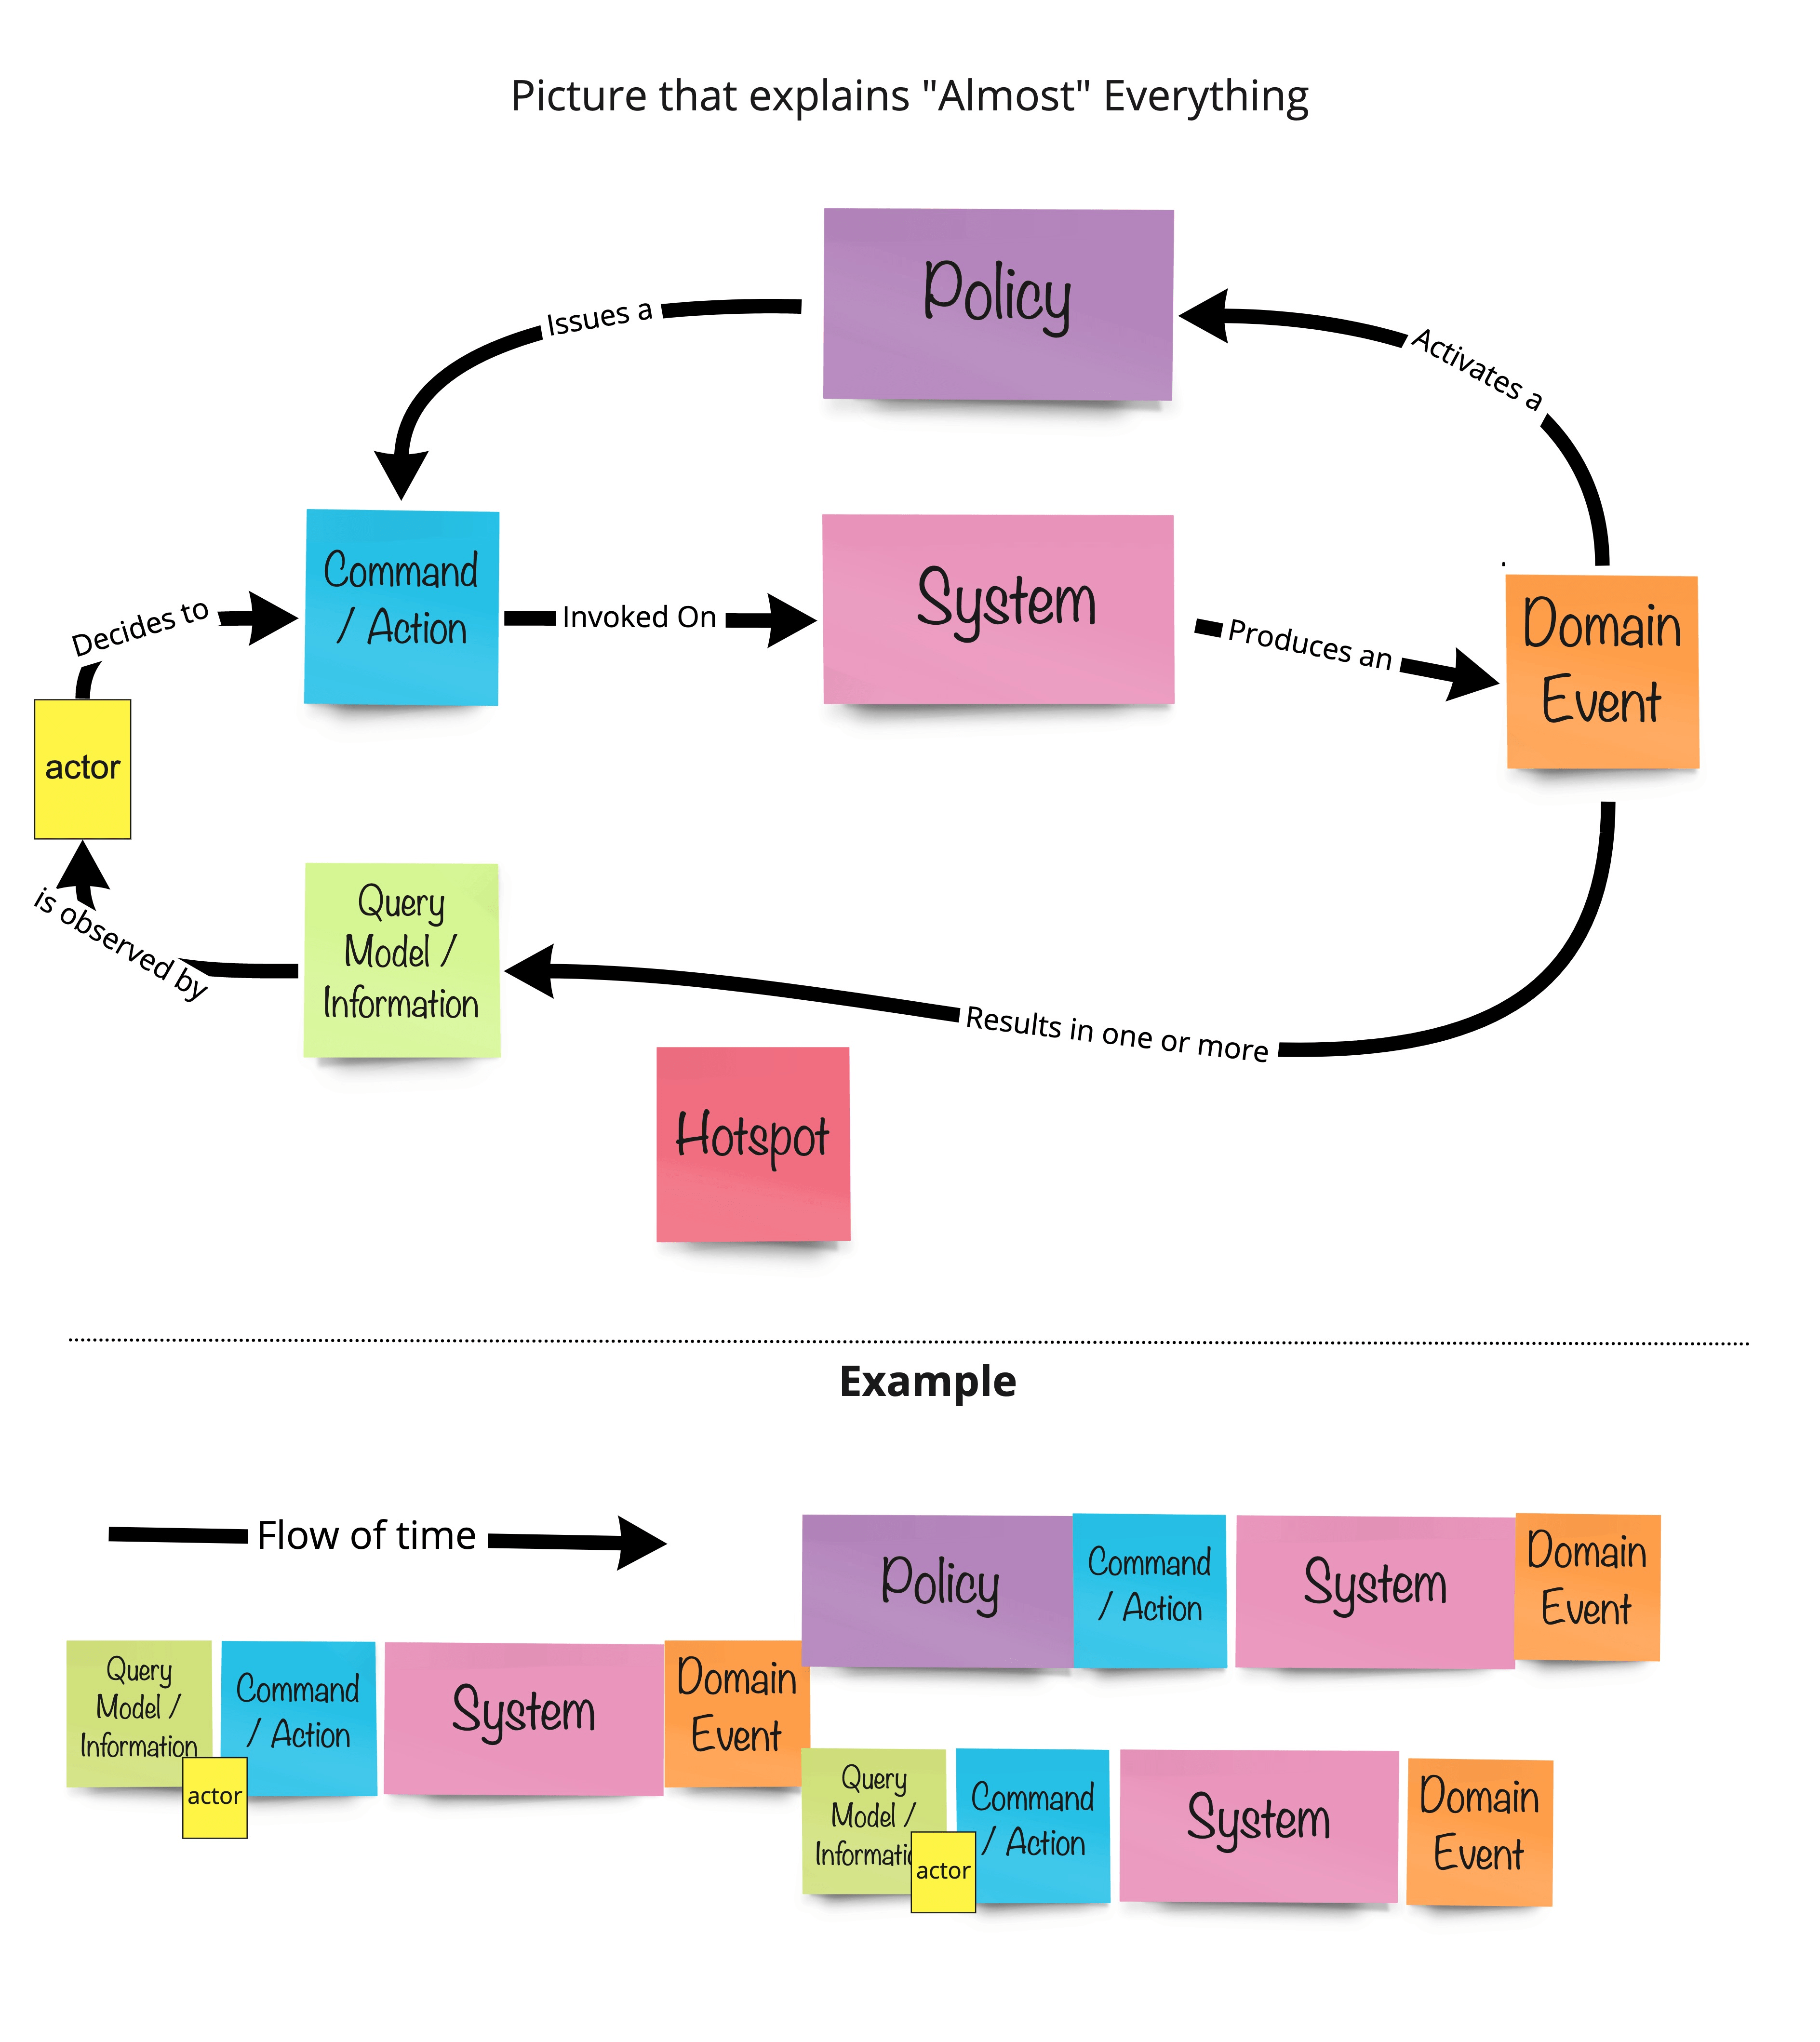

Slide 40
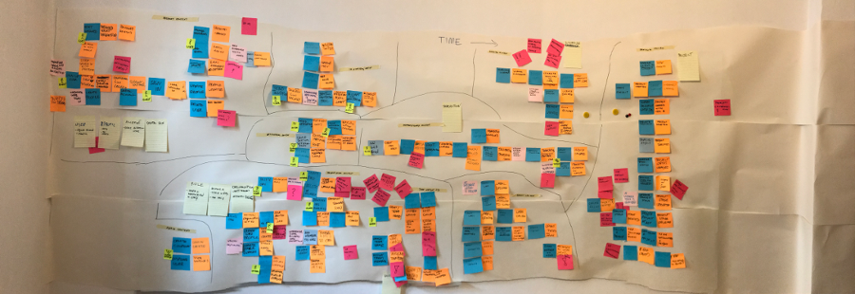
From: Robert Laszczak - https://threedots.tech

Slide 41
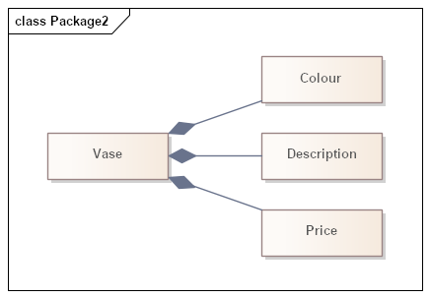
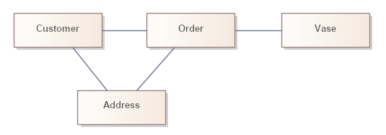
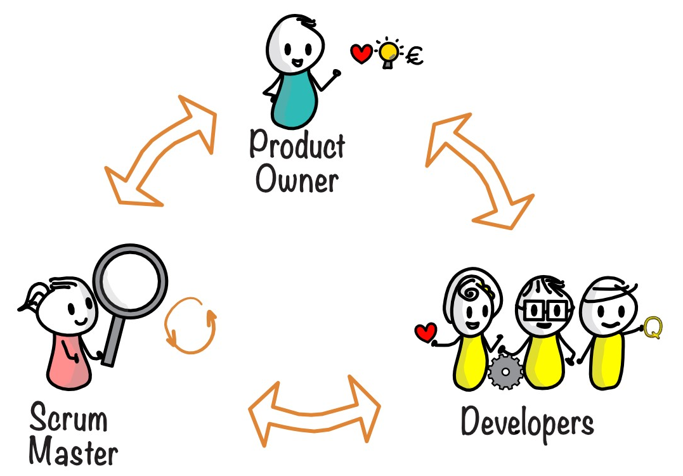
Publish
Order
Notes:
Also, reducing cognitive load

Slide 42
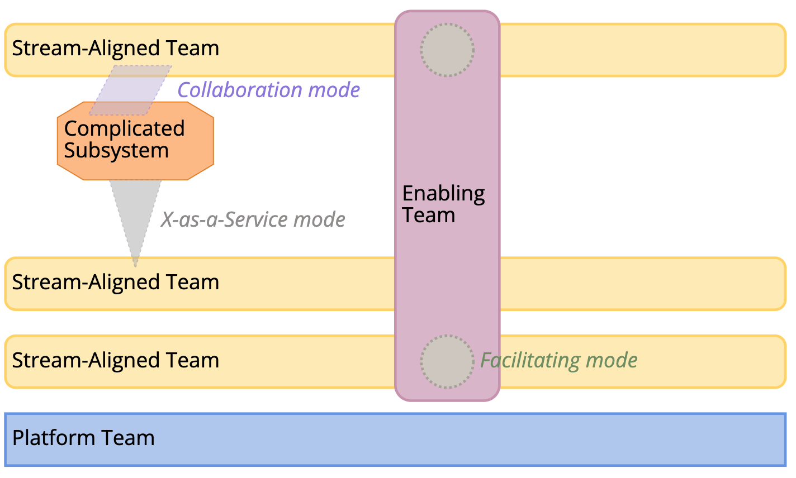

Slide 43
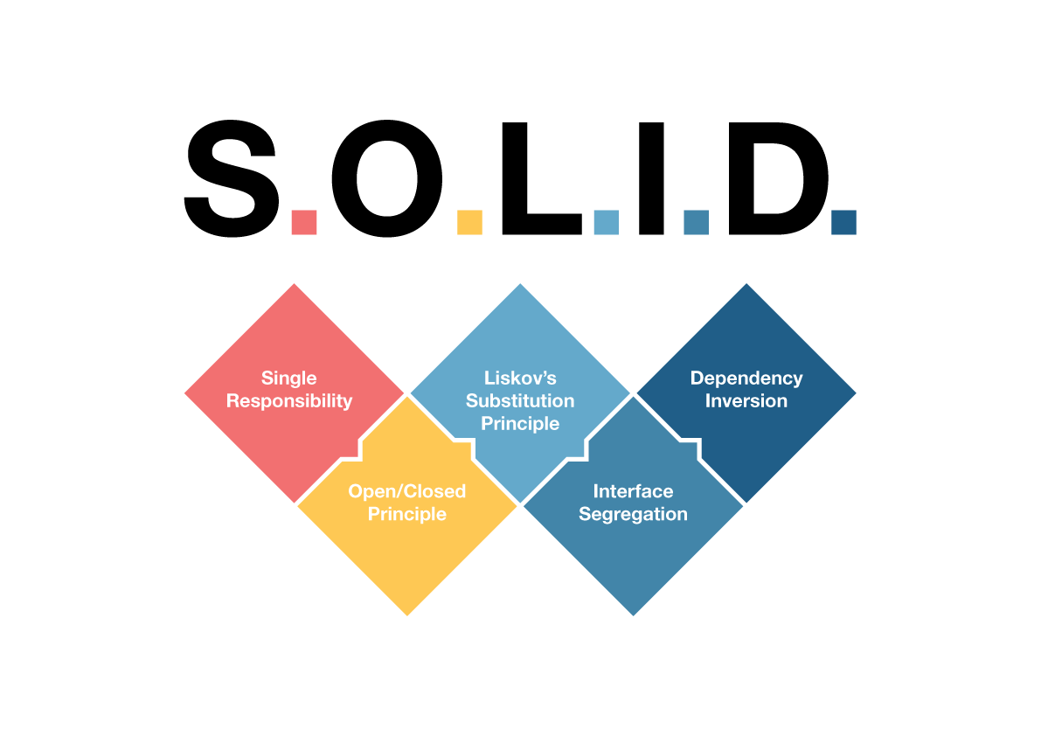

Slide 44
When should you use microservices?

Slide 46
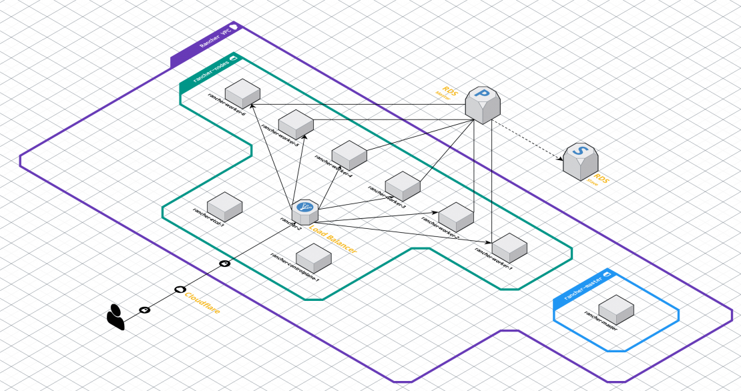

Slide 47

Microservices won’t eat your spaghetti
Microservice can be a good architecture, but not if the only reason is to break up the monolith.

